Slide 1
Final Project
Eric M. Abitbol

Slide 2
Introduction
A Hair Salon in Toronto is faced with no-shows and late cancellations 8%.
Objective: Build a predictive model that enables to detect a day before the potential bookings that can result in a noshow.
Prevention/solutions to reduce noshow rate after detection are out of scope
Data Source Kaggle.

Slide 3
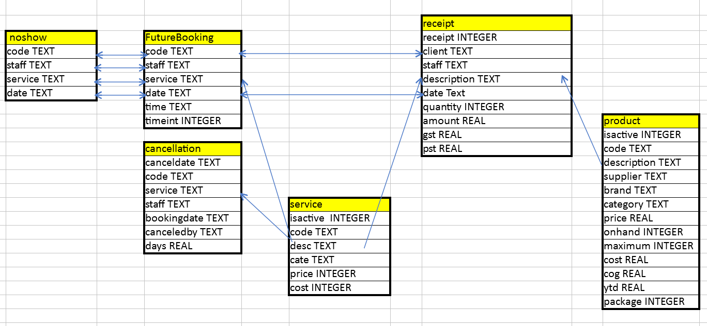


Data
Data CSV files
External Data: Holidays in Toronto. (cancellations on Monday or on holidays are considered as no-shows)

Slide 4
Data – Features
Booked Staff
Week in month (1..5)
Day in week (Monday to Sunday)
Hour
Day Hour combination
Average price of booked service
Multiple appointment indicator
Booked Service Type
Booked Service
First appearance
Previous no show
Existing Customer
Last Booked Staff
Last60days total bills , discounts [0 1]
Last60days color, product bills [0 1]
Last90days product buyer
Active bundle promo
Average price of previous service
#days since last effective appointment
#days since last noshow
#early cancellations in last 60 days
#eve cancleastions in last 60 days
Last effective booking day in week
Last effective booking hour
176 features after hot encoding of multi-class feature

Slide 5
EDA
Describe some important insights you get from the EDA
Add some tables and/or graphs that show the main findings

Slide 6
Outliers & Missing
Describe the outliers found
which techniques were implemented?
How do you treated them?
Describe the Missingness
How many?
Which variables were MCAR / MAR / MNAR?
How do you treated each?

Slide 7
Feature selection
Models comparison
Univariate, Logistic Regresion L1, Decision Tree, Random Forest,
SVM, Adaboost, Gradient boosting, Xgb
At least 4.
Cut-off Value : at least present in 4 models
39 features (out of 176) - 22%

Slide 8
Dataset partition
Describe how do you decided to partition your data
Partition method
Partitions
Train (%)
Dev (%)
Test (%)
How did you verified the partition balance

Slide 9
Model Selection
Describe the results and which model was selected and why.
The example here is only for a classification problem. For a regression problem we use other metrics.
Substitute with the metrics you had used in your project
Model | Train |  | Dev
 | AUC | Accuracy | AUC | Accuracy
Logistic | 0.743 | 0.810 | 0.722 | 0.633
Decision Tree | 0.781 | 0.797 | 0.764 | 0.700
Random Forest | 0.783 | 0.822 | 0.756 | 0.789
AdaBoost | 0.799 | 0.812 | 0.781 | 0.774
Gradient Boosting | 0.824 | 0.841 | 0.797 | 0.749
SVM | 0.803 | 0.833 | 0.786 | 0.769

Slide 10
Model Fine-tuning
Describe the hyperparameters which were used to fine-tuning the model
Describe which technique was used to iterate through the hyperparameter values (Grid vs Random search)
What results were obtained - compare between the metrics on the train-set, dev-set and the test-set

Slide 11
Conclusion
Comment here some insights you get from the whole process of your data science project.

